Slide 1
Favela Rising Background

Slide 2
Seating Chart
Tamara Woods | Syd Davis
Tori Mackey | Dontae Deere | Hans Amberg
David Oliva-Contreras | Jordan Bender | Daniel Bartley
Blackboard is here
Warren Montgomery | Xavier Rowlen-Davis
Miles Torrey | Kaily Rockwell | Essence Winfield
Kyron Tappin | Dustin Hansen | Cory Chanthaluxay
Daniel Strowmatt | Shateya Jackson | Tatyonna Winn | Edgar Perales
Adam Padron | Sarah Lowry | Tim King | Damion Davis

Slide 3
Seating Chart
Emma Lacefield | Shelby Burgin | Ti’erykah Wells
Naphtali Harris | Brendan Wells
Niarbre Mitchell | Brandi Willis | Zayah Cavette
Blackboard is here
Alante Peete | Raven Cooper
Josh Miller | Alex Joffe | Savannah McQueen
Mariah Martin | Ndumiso Madela | Nashawn Robinson-Mack
Alonzo Davis | Matthew Niehans | Kyle Fisher | Fatima Romero
Cole Moore | Chloe Smith | Dajonia Nesbitt | Mystikal Suggs
Shylloh Lee

Slide 4
Seating Chart
Fernando Magdelano | Susana Antonia | Isaias Perales
Alexander Marlow | Josefina Figuerosa | Vontice Minneman
Brittany McClain | Yesenia Hernandez | Isaac Moore
Blackboard is here
Vincent Edwards | Terron Miller
Josh Fuller | Brian King | Zecharias Hall
Matthew Dayton-Slade | Deshanea Wells | Malcolm Thompson
Isaiah D-B | Cameron Cradle | Brandon Smith | Kashira Moore
Kasjia Simmons | Matthew Tharp | Maritza Rodriguez | Rayshon Hutchinson
Kole Todd

Slide 5
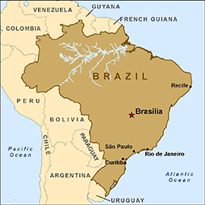
Brazil: What do we know?

Slide 6
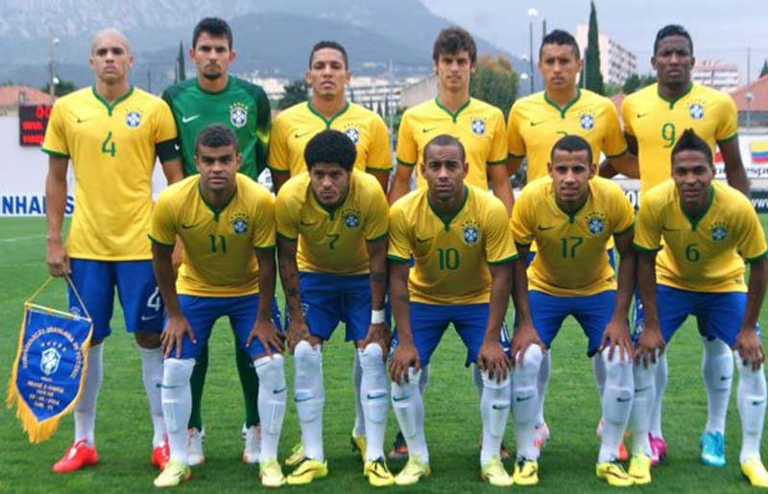
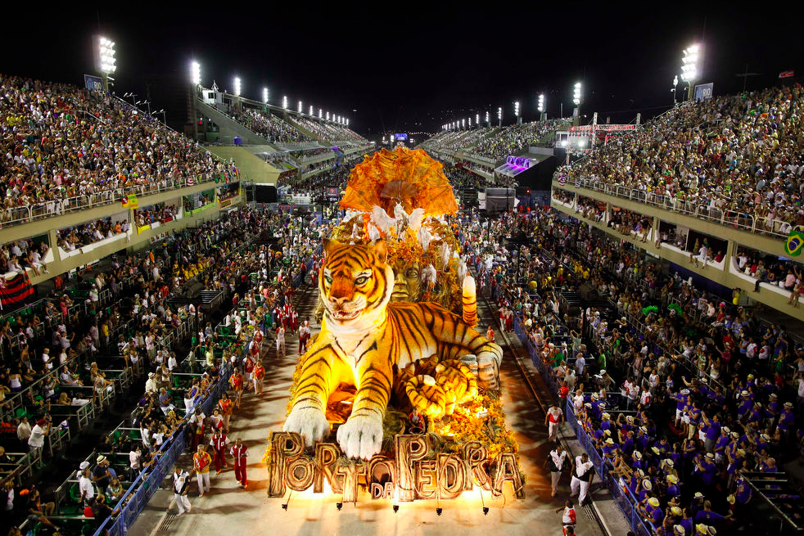
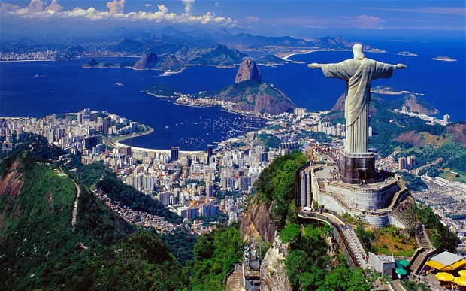
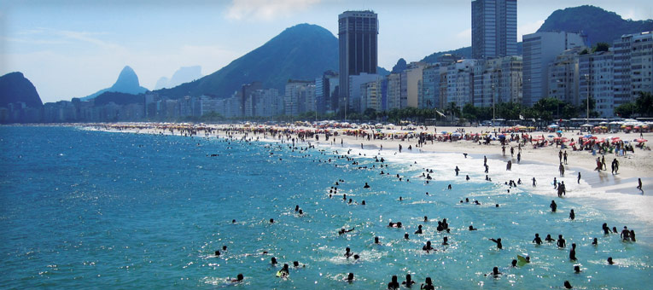
Brazil: What do we know?

Slide 7
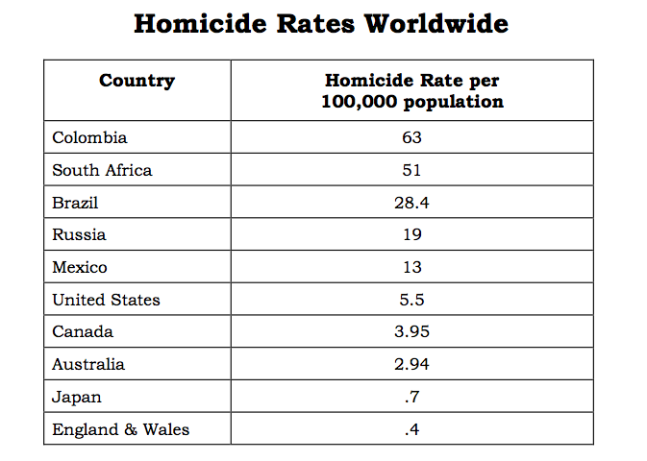
Well, did you know…
Brazil has the third highest murder rate in the world.

Slide 8
Well, did you know…
Here’s a comparison between US and Brazilian cities

Slide 9
Favela Rising
To explore these issues in Brazilian society we will watch the film Favela Rising, a documentary which follows an ex-drug trafficker who aims to use music to better the lives of people in Brazilian “Favelas” (Shantytowns).

Slide 10
The Human Thermometer
In order to explore the human issues associated with Brazil, we will use the Human Thermometer.
Remember that a thermometer measures heat. Let’s see how hot we feel about some of these ideas.

Slide 11
A single person cannot change a problem in a community
Strongly Agree
Strongly Disagree

Slide 12
Poverty causes violence
Strongly Agree
Strongly Disagree

Slide 13
Only a government can solve the problems in a community
Strongly Agree
Strongly Disagree

Slide 14
Music can change a person’s life
Strongly Agree
Strongly Disagree

Slide 15
Favela Rising Background Article
Important Information to Note:
Switzerland is known as one of the richest, most equality-based nations in the world
India is known as one of the poorest nations in the world. Here, the gap between rich and poor is huge, with people from different classes unable to change their station in life.
Genocide: the deliberate killing of a large group of people, especially those of a particular ethnic group or nation.
Social mobility: the ability of people to move from one social group to another.
Example: growing up in a poor environment, but working hard and ending up earning a high wage
Socioeconomic: relating to or concerned with the interaction of social and economic factors.
Example: race and class

